Slide 1
FRUITs CLASSIFICATION USING deep LEARNING Capstone project for Advanced Certification Course in Machine Learning and AI by iit roorkee and cloudxlab
Hiral Kanani

Slide 2
Objective:
To develop a model that can detect different types of fruits and vegetables from their images
To classify 131 categories of fruits and vegetables
Use the developed model to make a mobile app

Slide 3
Dataset:
Fruits 360 -A dataset with 90380 images of 131 fruits and vegetables
Available on Kaggle
Preprocessed dataset divided into train and test set
Train set is further divided into train and validation sets in this project
Train set 50769
Validation set 16923
Test set 22688

Slide 4
Approach:
Tensorflow data object - Dataset for train , validation and test sets
Data augmentation
Baseline Model- CNN with 2 convolutional layers
Transfer learning- pretrained models
ResNet50V2
EfficientNetB3

Slide 5
Model Summary(Baseline-CNN):
Model: "sequential_12"
Layer (type) Output Shape Param # =================================================================
conv2d_9 (Conv2D) (None, 224, 224, 16) 208
max_pooling2d_9(MaxPooling2D) (None, 112, 112, 16) 0
conv2d_10 (Conv2D) (None, 112, 112, 32) 2080
max_pooling2d_10(MaxPooling2D) (None, 56, 56, 32) 0
dropout_12 (Dropout) (None, 56, 56, 32) 0
flatten_4 (Flatten) (None, 100352) 0
dense_20 (Dense) (None, 500) 50176500
dropout_13 (Dropout) (None, 500) 0
dense_21 (Dense) (None, 131) 65631 ================================================================= Total params: 50,244,419
Trainable params: 50,244,419
Non-trainable params: 0 _____________________________

Slide 6
Model Summary(ResNet50V2+CNN):
Model: "sequential_13" _________________________________________________________________ Layer (type) Output Shape Param # ================================================================= resnet50v2 (Functional) (None, 7, 7, 2048) 23564800
global_average_pooling2d_6 (None, 2048) 0
(GlobalAveragePooling2D)
dense_22 (Dense) (None, 131) 268419 ================================================================= Total params: 23,833,219
Trainable params: 23,787,779
Non-trainable params: 45,440

Slide 7
Model Summary(EfficientNetB3+CNN):
Model: "sequential_14"
Layer (type) Output Shape Param # ================================================================= efficientnetb3 (Functional) (None, 7, 7, 1536) 10783535
global_average_pooling2d_7 (None, 1536) 0
(GlobalAveragePooling2D)
dropout_14 (Dropout) (None, 1536) 0
dense_23 (Dense) (None, 128) 196736
dense_24 (Dense) (None, 131) 16899 ================================================================= Total params: 10,997,170
Trainable params: 10,909,867
Non-trainable params: 87,303
_________________________________

Slide 8
Results:
Model | loss | accuracy | Val_loss | Val_accuracy
Baseline(CNN) | 2.2941 | 0.3666 | 9.1629 | 0.1123
ResNet50V2+CNN | 0.0446 | 0.9866 | 1.8987 | 0.6526
EfficientNetB3+CNN | 0.0496 | 0.9857 | 1.6157 | 0.6907
Model | precision | recall | Val_precision | Val_recall
Baseline(CNN) | 0.6849 | 0.2278 | 0.1554 | 0.0758
ResNet50V2+CNN | 0.9879 | 0.9857 | 0.6785 | 0.6377
EfficientNetB3+CNN | 0.9872 | 0.9846 | 0.7288 | 0.6678

Slide 9
Evaluation on test data:
Model | loss | accuracy | precision | recall
Baseline(CNN) | 4.8140 | 0.2180 | 0.2369 | 0.2880
ResNet50V2+CNN | 1.8529 | 0.6589 | 0.6871 | 0.6403
EfficientNetB3+CNN | 0.7184 | 0.8173 | 0.8379 | 0.8043

Slide 10
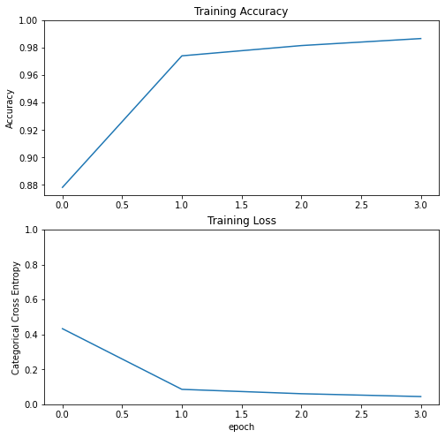
ResNet50V2+CNN:

Slide 11
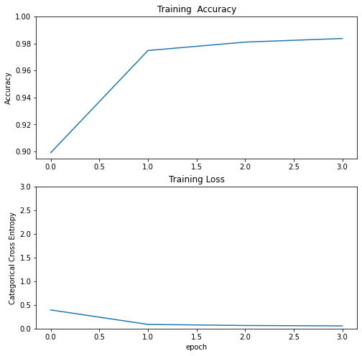
EfficientNetB3+CNN:

Slide 12
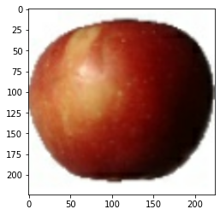
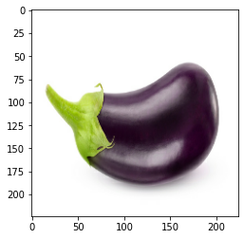
Inference(Baseline):
RealtimePrediction("/content/fruits-360/Test/Apple Braeburn/321_100.jpg" , model , Le)
Apple Red Yellow 2
# Prediction on the image from internet
RealtimePrediction("/content/eggplant.jpg" , model , Le)
Melon Piel de Sapo

Slide 13
Inference(ResNet50V2+CNN):
RealtimePrediction("/content/fruits-360/Test/Apple Braeburn/321_100.jpg" , model , Le)
Apple Braeburn
# Prediction on the image from internet
RealtimePrediction("/content/eggplant.jpg" , model , Le)
Corn Husk

Slide 14
Inference(EfficientNetB3+CNN):
RealtimePrediction("/content/fruits-360/Test/Apple Braeburn/321_100.jpg" , model , Le)
Apple Braeburn
# Prediction on the image from internet
RealtimePrediction("/content/eggplant.jpg" , model , Le)
Eggplant

Slide 15
Other Comments:
Performance Improvement :
Divide training in two phases
Try other pretrained models
Future Work:
Deployment on web
Mobile app

Slide 16
References:
https://github.com/satishf889/Fruit-Classifier-Model/
Fruit recognition from images using deep learning, June 2018 ,Acta Universitatis Sapientiae, Informatica 10(1):26-42 ,DOI:10.2478/ausi-2018-0002
Kaggle.com
https://keras.io/api/applications/resnet/
https://keras.io/api/applications/efficientnet/
https://www.tensorflow.org/api_docs/python/tf/data/Dataset

Slide 17
Thank You

